Slide 1
Stacks
© 2013 Goodrich, Tamassia, Goldwasser
Stacks

Slide 2
Abstract Data Types (ADTs)
An abstract data type (ADT) is an abstraction of a data structure
An ADT specifies:
  Data stored
  Operations on the data
  Error conditions associated with operations
Example: ADT modeling a simple stock trading system
  The data stored are buy/sell orders
  The operations supported are
    order buy(stock, shares, price)
    order sell(stock, shares, price)
    void cancel(order)
  Error conditions:
    Buy/sell a nonexistent stock
    Cancel a nonexistent order
© 2013 Goodrich, Tamassia, Goldwasser
Stacks

Slide 3

The Stack ADT
The Stack ADT stores arbitrary objects
Insertions and deletions follow the last-in first-out scheme
Think of a spring-loaded plate dispenser
Main stack operations:
  push(object): inserts an element
  object pop(): removes and returns the last inserted element
Auxiliary stack operations:
  object top(): returns the last inserted element without removing it
  integer len(): returns the number of elements stored
  boolean is_empty(): indicates whether no elements are stored
© 2013 Goodrich, Tamassia, Goldwasser
Stacks

Slide 4
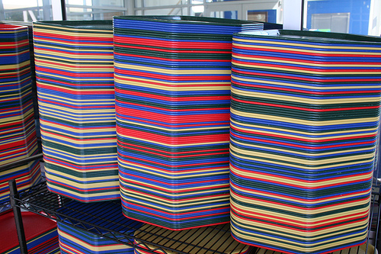
Stacks
Last In First Out (LIFO)
  Remove the most recently added item
  Analogy: cafeteria trays

Slide 5
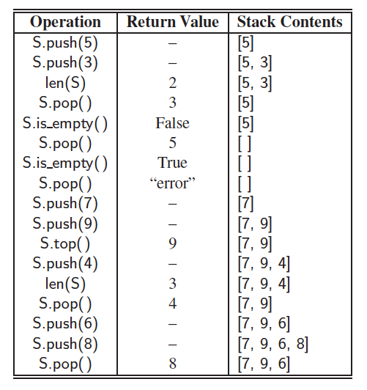
Example
© 2013 Goodrich, Tamassia, Goldwasser
Stacks

Slide 6
Applications of Stacks
Direct applications
  Page-visited history in a Web browser
  Undo sequence in a text editor
  Chain of method calls in a language that supports recursion
  Parsing in a compiler
Indirect applications
  Auxiliary data structure for algorithms
  Component of other data structures
© 2013 Goodrich, Tamassia, Goldwasser
Stacks

Slide 7
Array-based Stack
A simple way of implementing the Stack ADT uses an array
We add elements from left to right
A variable keeps track of the index of the top element
…
S
0
1
2
t
© 2013 Goodrich, Tamassia, Goldwasser
Stacks

Slide 8
Array-based Stack (cont.)
The array storing the stack elements may become full
A push operation will then need to grow the array and copy all the elements over.
…
S
0
1
2
t
© 2013 Goodrich, Tamassia, Goldwasser
Stacks

Slide 9
Let’s Implement a simple Stack using Python’s List Class
Open array_stack_student.py from brightspace.nyu.edu
Fill in the #to do part to implement a stack
We will implement ArrayStack Class.
Submit your code to Gradescope
© 2013 Goodrich, Tamassia, Goldwasser
Stacks

Slide 10
Performance and Limitations
Performance
  Let n be the number of elements in the stack
  The space used is O(n)
  Each operation runs in time O(1) (amortized in the case of push & pop due to resizing)
© 2013 Goodrich, Tamassia, Goldwasser
Stacks

Slide 11
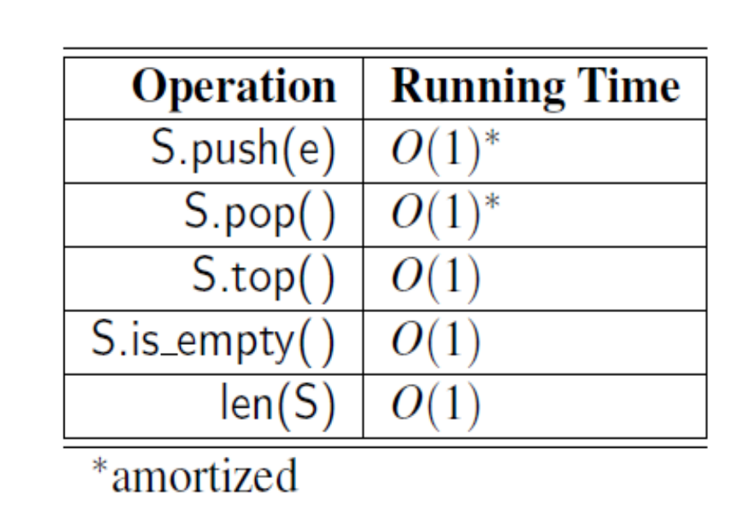
Analyzing the Array-Based Stack
© 2013 Goodrich, Tamassia, Goldwasser
Stacks

Slide 12
Let’s use our simple Stack to reverse a file
Open reverse_file_student.py from Brightspace
Fill in the #to do part to reverse the file contents of DSSyllabus.txt
Use ArrayStack class in array_stack_student.py file to implement your solution
Submit the 3 files to Gradescope
© 2013 Goodrich, Tamassia, Goldwasser
Stacks

Slide 13
Parentheses Matching (Application of Stack)
Each “(”, “{”, or “[” must be paired with a matching “)”, “}”, or “[”
  correct: ( )(( )){([( )])}
  correct: ((( )(( )){([( )])}))
  incorrect: )(( )){([( )])}
  incorrect: ({[ ])}
  incorrect: (
© 2013 Goodrich, Tamassia, Goldwasser
Stacks
Notes:
[ ]: square bracket
( ): parentheses
{ }: brace or curly bracket
< >: pointy bracket or inequality sign

Slide 14
Parentheses Matching Algorithm
Algorithm ParenMatch(X,n):
Input: An array X of n tokens, each of which is either a grouping symbol, a
variable, an arithmetic operator, or a number
Output: true if and only if all the grouping symbols in X match
Let S be an empty stack
for i=0 to n-1 do
if X[i] is an opening grouping symbol then
S.push(X[i])
else if X[i] is a closing grouping symbol then
if S.is_empty() then
return false {nothing to match with}
if S.pop() does not match the type of X[i] then
return false {wrong type}
if S.isEmpty() then
return true {every symbol matched}
else return false {some symbols were never matched}
© 2013 Goodrich, Tamassia, Goldwasser
Stacks

Slide 15
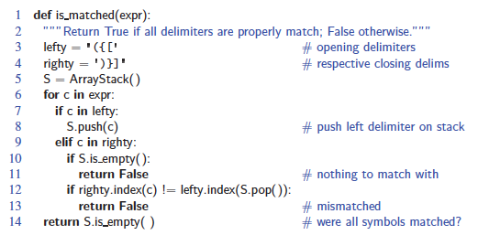
Parentheses Matching in Python
© 2013 Goodrich, Tamassia, Goldwasser
Stacks

Slide 16
HTML Tag Matching (Application of Stack)
For fully-correct HTML, each <name> should pair with a matching </name>
<body>
<center>
<h1> The Little Boat </h1>
</center>
<p> The storm tossed the little
boat like a cheap sneaker in an
old washing machine. The three
drunken fishermen were used to
such treatment, of course, but
not the tree salesman, who even as
a stowaway now felt that he
had overpaid for the voyage. </p>
<ol>
<li> Will the salesman die? </li>
<li> What color is the boat? </li>
<li> And what about Naomi? </li>
</ol>
</body>
The Little Boat
The storm tossed the little boat
like a cheap sneaker in an old
washing machine. The three
drunken fishermen were used to
such treatment, of course, but not
the tree salesman, who even as
a stowaway now felt that he had
overpaid for the voyage.
1. Will the salesman die?
2. What color is the boat?
3. And what about Naomi?
© 2013 Goodrich, Tamassia, Goldwasser
Stacks

Slide 17
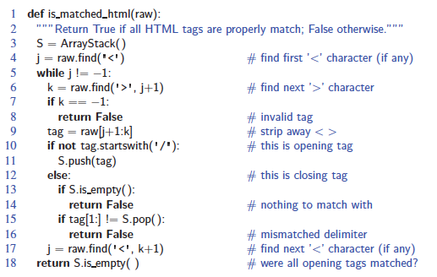
Tag Matching Algorithm in Python
© 2013 Goodrich, Tamassia, Goldwasser
Stacks
Notes:
raw: a string

Slide 18
Evaluating Arithmetic
Expressions
Slide by Matt Stallmann included with permission.
14 – 3 * 2 + 7 = (14 – (3 * 2) ) + 7
Operator precedence
* has precedence over +/–
Associativity
operators of the same precedence group
evaluated from left to right
Example: (x + y) + z rather than x + (y + z)
Idea: 1) push each operator on the stack, but first pop and perform higher and equal precedence operations.
2) Use 2 stacks: one to hold operands; another one to hold operators
© 2013 Goodrich, Tamassia, Goldwasser
Stacks
Notes:
(x + y) + z rather than x + (y + z), this means that executing the stack (if it could) has the highest priority

Slide 19
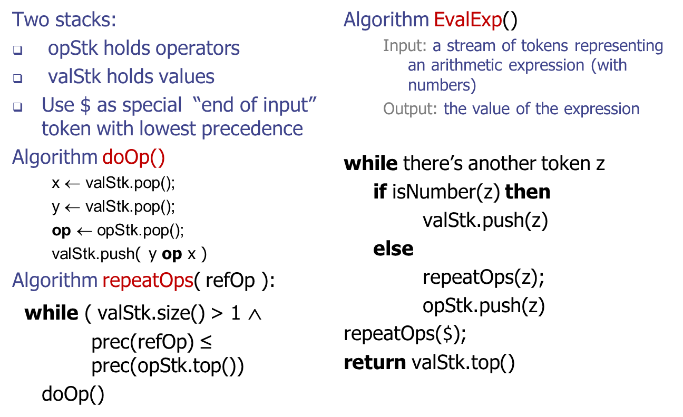
Algorithm for
Evaluating Expressions
Slide by Matt Stallmann included with permission.
© 2013 Goodrich, Tamassia, Goldwasser
Stacks

Slide 20
Algorithm on an
Example Expression
Slide by Matt Stallmann included with permission.
Operator ≤ has lower precedence than +/–
14 ≤ 4 – 3 * 2 + 7
4
–
14
≤
3
*
$
$
4
–
7
$
14
≤
F
+
-2
+
5
+
14
≤
14
≤
2
2
3
*
3
*
6
4
–
4
–
4
–
-2
+
14
≤
14
≤
14
≤
14
≤
© 2013 Goodrich, Tamassia, Goldwasser
Stacks

